Slide 1

DataQuest 2024: Team 15
Michael Quick, Josh Muszka,
Eunsung Kim, Nick Woo

Slide 2
Our problem
Credit card fraud affects millions of Americans every year
Millions of consumers' finances on the line
Additionally, businesses and financial organizations lose revenue and reputation
Overall, fraud leads to immense losses and negative impacts on the economy

Slide 3
What should we do?
What do fraudulent transactions have in common?
Each transaction involves the name of a person, location and time of transaction, the parties involved, and many other factors
To mitigate credit card fraud, we need to be able to predict if a transaction is fraudulent based on its characteristics

Slide 4
How to make predictions
Machine learning is suitable for making predictions in situations with many variables, relations, and co-factors
With a large dataset of past transactions, we can train a model to make predictions about future transactions
With skillful design and execution, our model can be accurate and precise, with high recall
We used Python and various libraries to create our model
numpy, pandas, scikit-learn

Slide 5
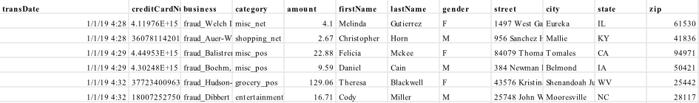
The dataset
The dataset contained several features which could be useful in determining fraud
Many of these features could be difficult for a human to find a co-relation with

Slide 6
Preprocessing the data
Preprocessing helps to make better data which can improve the performance and accuracy of the model
Standard scalar helps to deal with “badly behaving” features
OneHotEncoder turns categorical features into usable binary features
SelectKBest chooses the best performing features to focus on

Slide 7
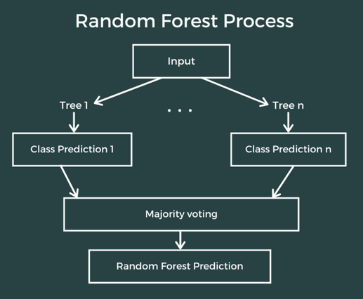
Training the model
XGBoost was our model of choice
It was trained with the training sheet
It thenwas used to predict the values

Slide 8
Results
[accuracy] - 99.8%
[precision] - 94.9%
[recall] - 82.6%
[f1 score] - 88.3%
The first run of a dataset can take a significantly long time
Future runs of datasets take only minutes
Overall, relatively accurate and efficient

Slide 9
What next?
While our model was successful, that does not mean it cannot be improved
More research and development:
Optimizing the preprocessing, experimenting with different classifiers/models
This will improve accuracy and performance
Faster processing power:
Investing in more powerful computers = better performance and capabilities
Will allow for less constraints and less sacrifices to be made

Slide 10
Plans
With our model, we can provide valuable services to a variety of clients
Merchants can save money by catching fraudulent transactions swiftly after they occur
Banks and financial institutions will need less resources to investigate and resolve credit card fraud
Customers will be more inclined to spend money at places proven to be safe and secure
And with further investment, our model will be ever more helpful to those in need

